Slide 1
Operations on Discrete Time Signal lecture 4

Slide 2
Time Shifting
Let x[n] be a discrete time signal. Then the time-shifted version of x[n] is defined by,
y[n]=x[n-m]
where, the shift m must be a positive or negative integer. If m>0 the discrete signal y[n] is obtained by shifting x[n] toward the right, relative to the time axis. If m<0, x[n] is shifted to the left.

Slide 3
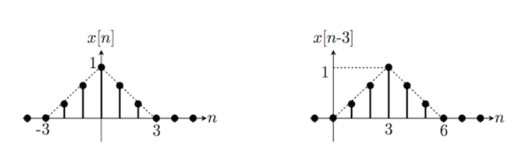
Time Shifting
Figure: x[n-3] moves (delays) x to the right by 3

Slide 4
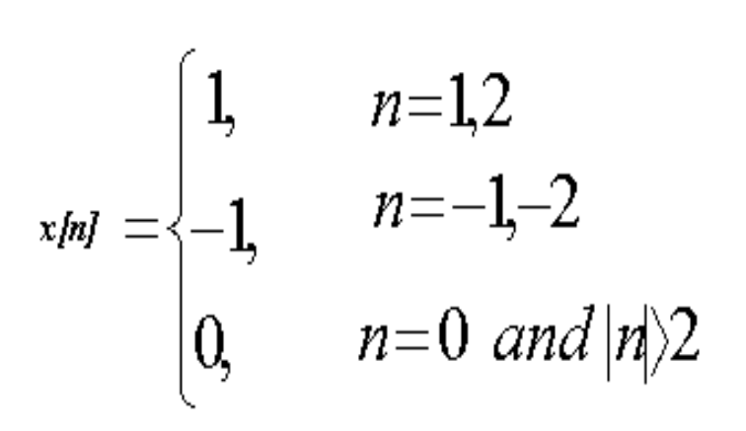
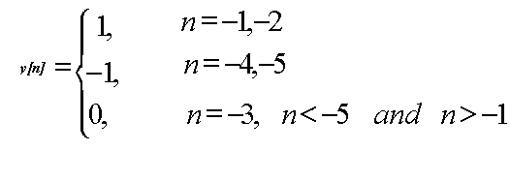
Time Shifting-Problem
Given,
Find the time shifted signal y[n]=x[n+3]
Answer,

Slide 5
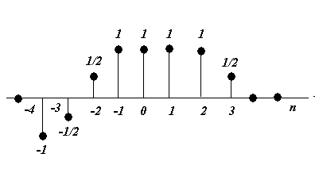
Time Shifting-Problem
A discrete time signal x(t) is shown in figure. Sketch the signal y[n]=x[n-4] and x[n+4], derived from x[n].

Slide 6
Time Scaling
Let x[n] be a discrete time signal. The signal obtained by scaling the independent variable n by k is defined by,
y[n]=x[kn]
which is defined only for integer values k. Here, k is called the scaling factor.

Slide 7
Time Scaling
If the independent variable n is replaced by kn and k>0, the signal is compressed. This can be achieved by dividing every time instant in signal x[n] by ‘k’.
If the independent variable n is replaced by kn and 0<k<1, the signal is expanded. This can be achieved by dividing every time instant in signal x[n] by ‘k’. The standard convention in expansion is to fill in the undetermined values with zeros.

Slide 8
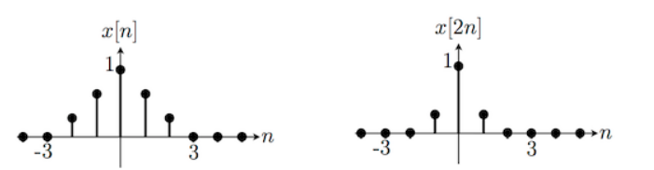
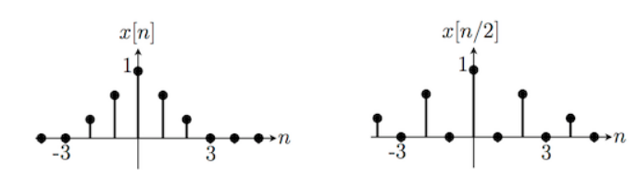
Time Scaling

Slide 9
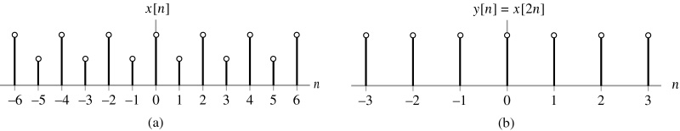
Time Scaling
Effect of time scaling on a discrete-time signal: (a) discrete-time signal x[n] and (b) version of x[n] compressed by a factor of 2, with some values of the original x[n] lost as a result of the compression.

Slide 10

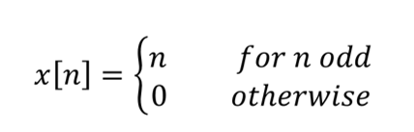
Time Scaling
Determine y[n]= x[2n]
Ans: y[n]=0 for all n.

Slide 11
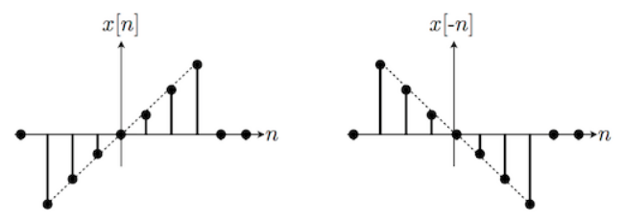
Time Reversal (Reflection)
Let x[n] be a discrete time signal. Let y[n] denote the signal obtained by replacing n with –n; that is ,
y[n]=x[-n]
The signal y[n] represents a reflected version of x[n] about n=0.

Slide 12
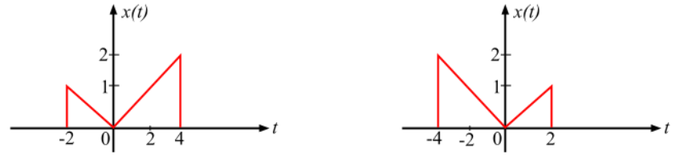
Time Reversal (Reflection)
Time reversal of a continuous time signal

Slide 13
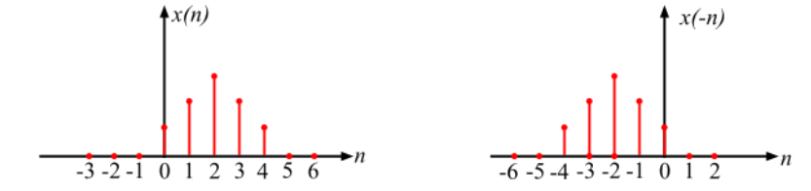
Time Reversal (Reflection)
Time reversal of a discrete time sequence

Slide 14
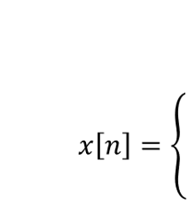



Time Reversal (Problem)
Given the Discrete time signal x[n]. Draw the signal Find y[n]=x[-n] and then find z[n]=x[n]+x[-n].

Slide 15
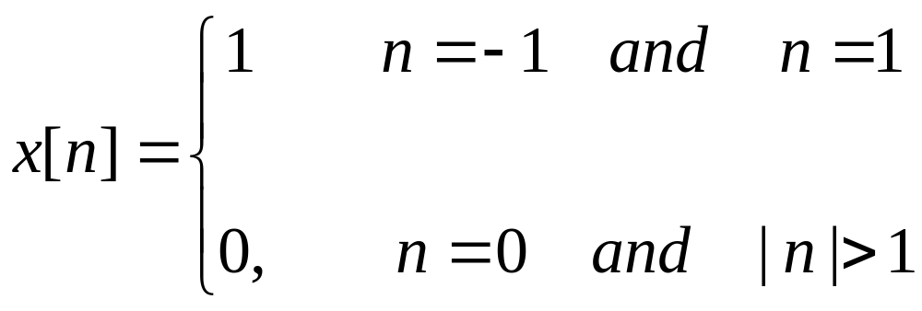
Time Reversal (Problem)
Given the Discrete time signal x[n]. Draw the signal Find y[n]=x[-n] and then find z[n]=x[n]+x[-n].

Slide 16
Precedence Rule Discrete Time Signal
Suppose we would like to determine the effect of transforming the independent variable of a given discrete time signal x[n] to obtain a signal of the form x[an+b], where a and b are given number. A systematic approach to doing this is to first delay or advance x[n] in accordance with the value of b and then to perform time scaling and/or time reversal on the resulting signal in accordance with the value of a.

Slide 17
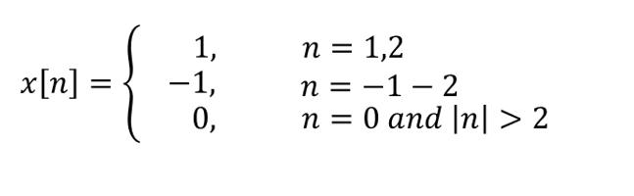
Precedence Rule Discrete Time Signal
A discrete time signal is defined by,
y[n]=x[2n+3].

Slide 18
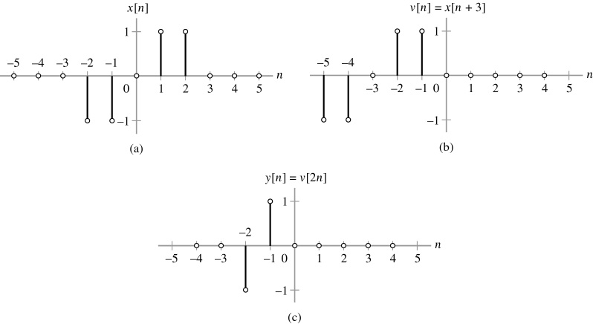
Precedence Rule Discrete Time Signal

Slide 19
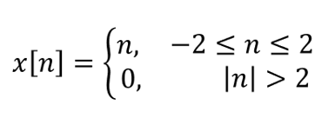
Precedence Rule Discrete Time Signal
Consider a discrete time signal
Find y[n]=x[3n-1].

Slide 20
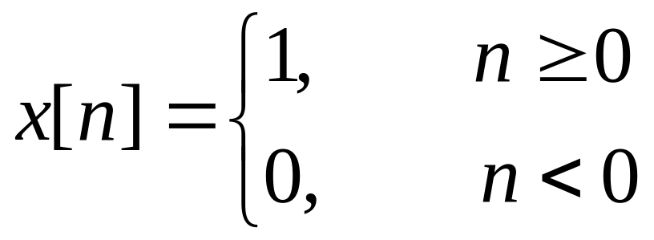
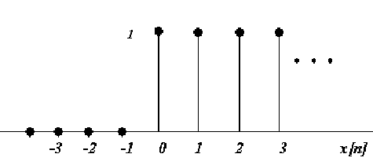
Even and odd Component of discrete time signal

Slide 21
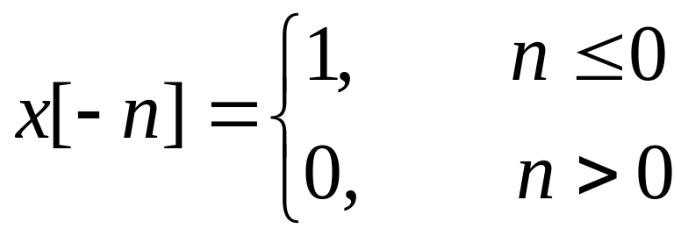
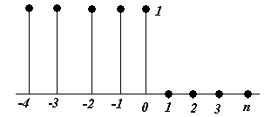
Even and odd Component of discrete time signal

Slide 22
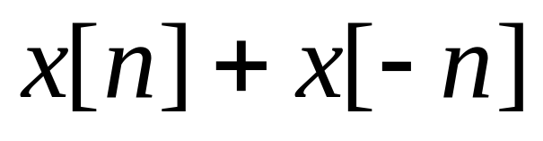
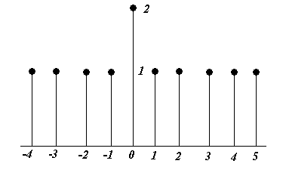
Even and odd Component of discrete time signal

Slide 23
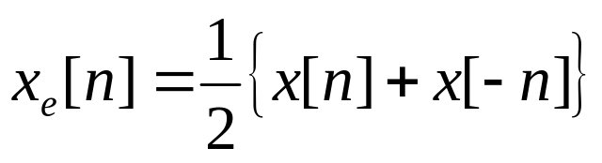
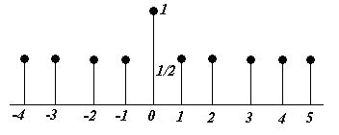
Even and odd Component of discrete time signal

Slide 24
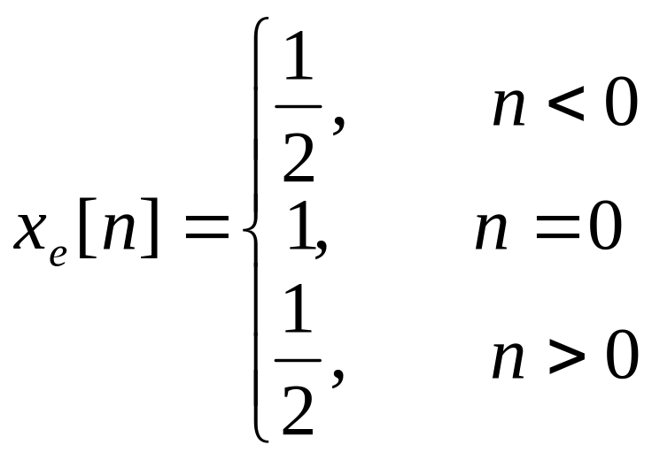
Even and odd Component of discrete time signal

Slide 25
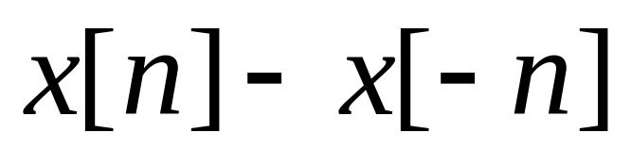
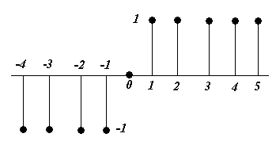
Even and odd Component of discrete time signal

Slide 26
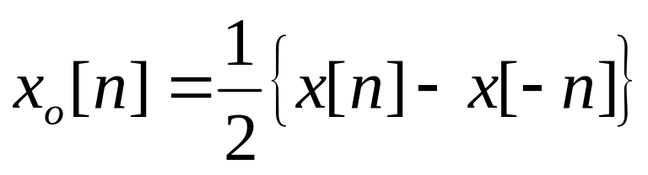
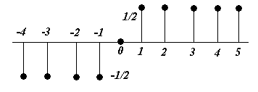
Even and odd Component of discrete time signal

Slide 27
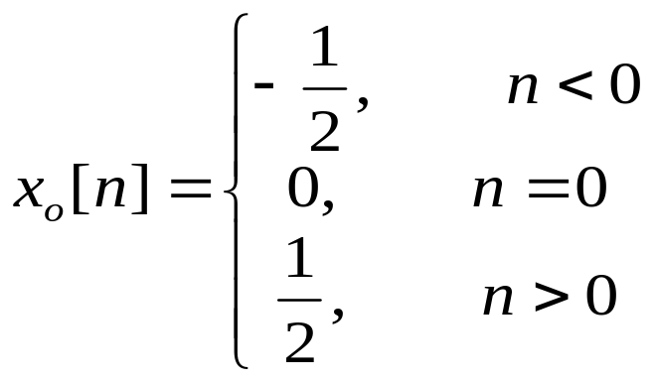
Even and odd Component of discrete time signal

Slide 28
Even and odd Component of discrete time signal
+

Slide 29
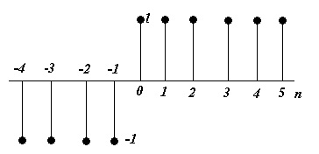
Even and odd Component of discrete time signal
Problem
Determine and sketch the even and odd parts of the signal shown below. Label your sketches carefully.

Slide 30
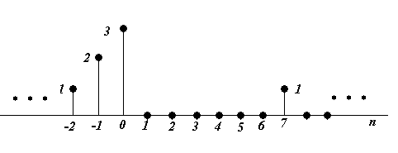
Even and odd Component of discrete time signal
Problem
Determine and sketch the even and odd parts of the signal shown below. Label your sketches carefully.

Slide 31
End

